Slide 1

CSE 3901- Project 6
Group 5 - Jay Shin, Klejdi Vrekaj, Riley Gillman, Robbie Rogers

Slide 2

Problem
We are lacking presentation feedback tools that will be used by audience members to give the instructor extra feedback to use in grading individual assignments and give them constructive criticism in their presentation.

Slide 3
What We Did
Built a presentation feedback tool that…
Allows the instructor to create events.
Allows audience members to submit feedback.
Allows the instructor to have an administrative interface.
Allows presenter to view their feedback.

Slide 4
Timeline
Implemented sign in, sign out, log in & log out.
Implemented adding/deleting feedback and different sections of feedback.
Implemented different views for students in each group and professors
Implemented class roster and adding assignments

Slide 5
Tools Used
Ruby on Rails
Devise (Ruby Gem)
HTML / CSS
Git

Slide 6
Features
Presentation Evaluation Tool
Copyrightⓒ. Saebyeol Yu. All Rights Reserved.

Slide 7
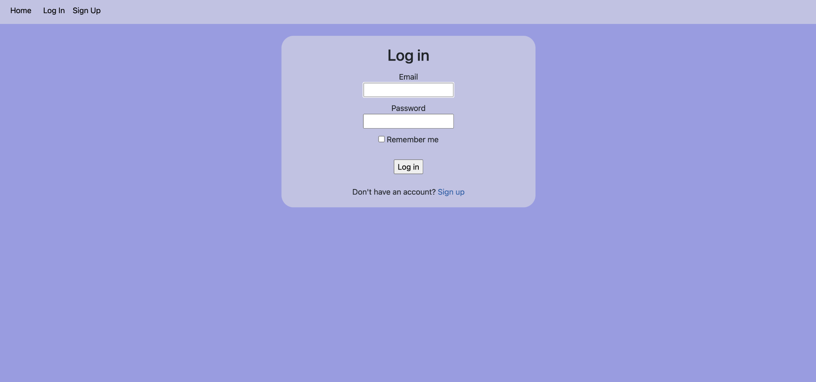
Main Page

Slide 8
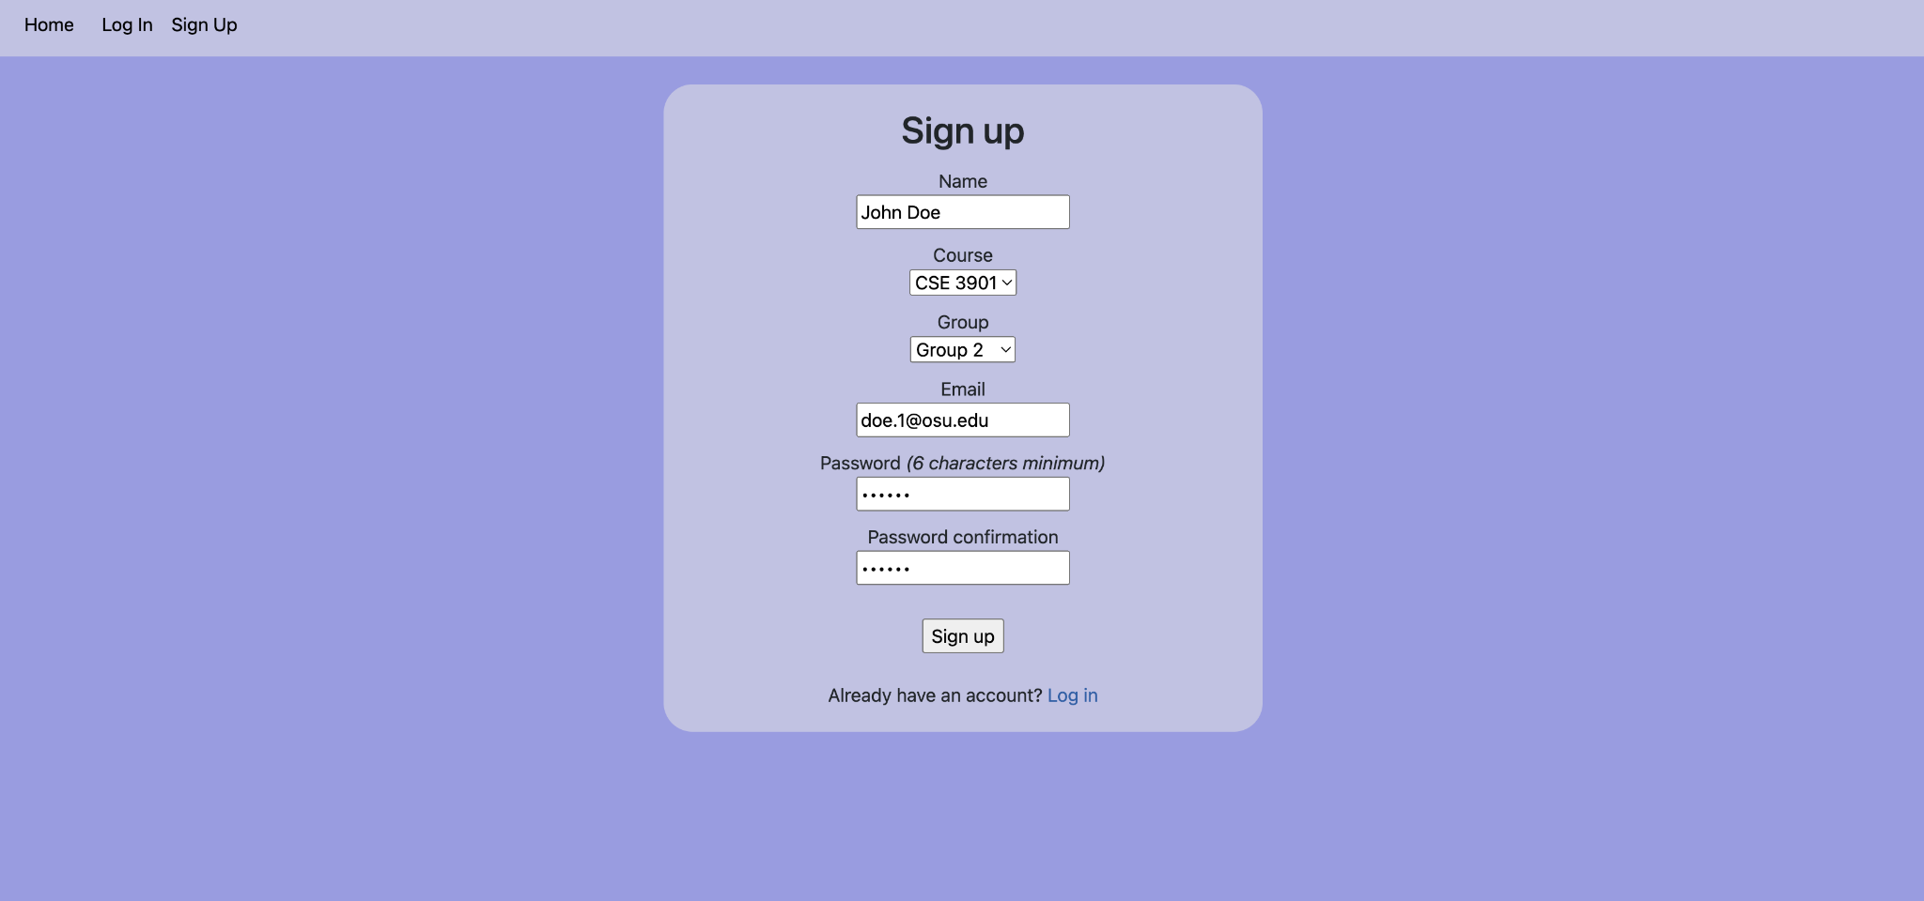
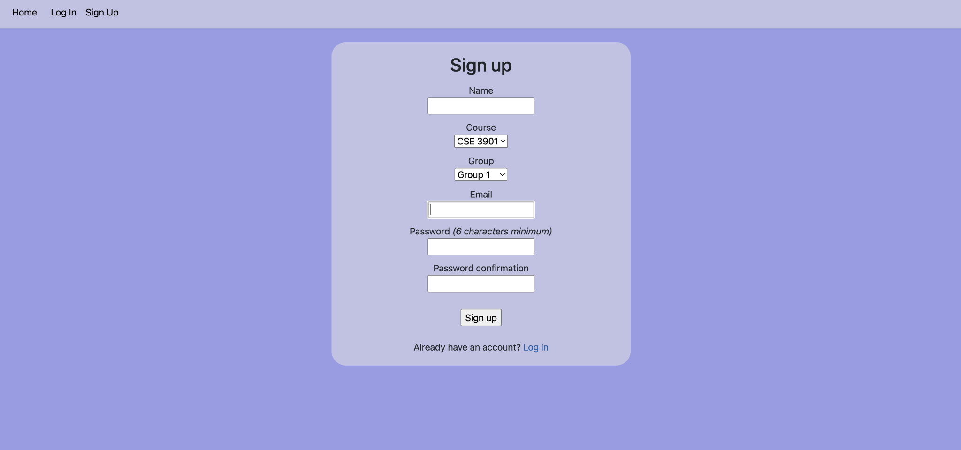
Sign Up
as a Student in Group 2

Slide 9
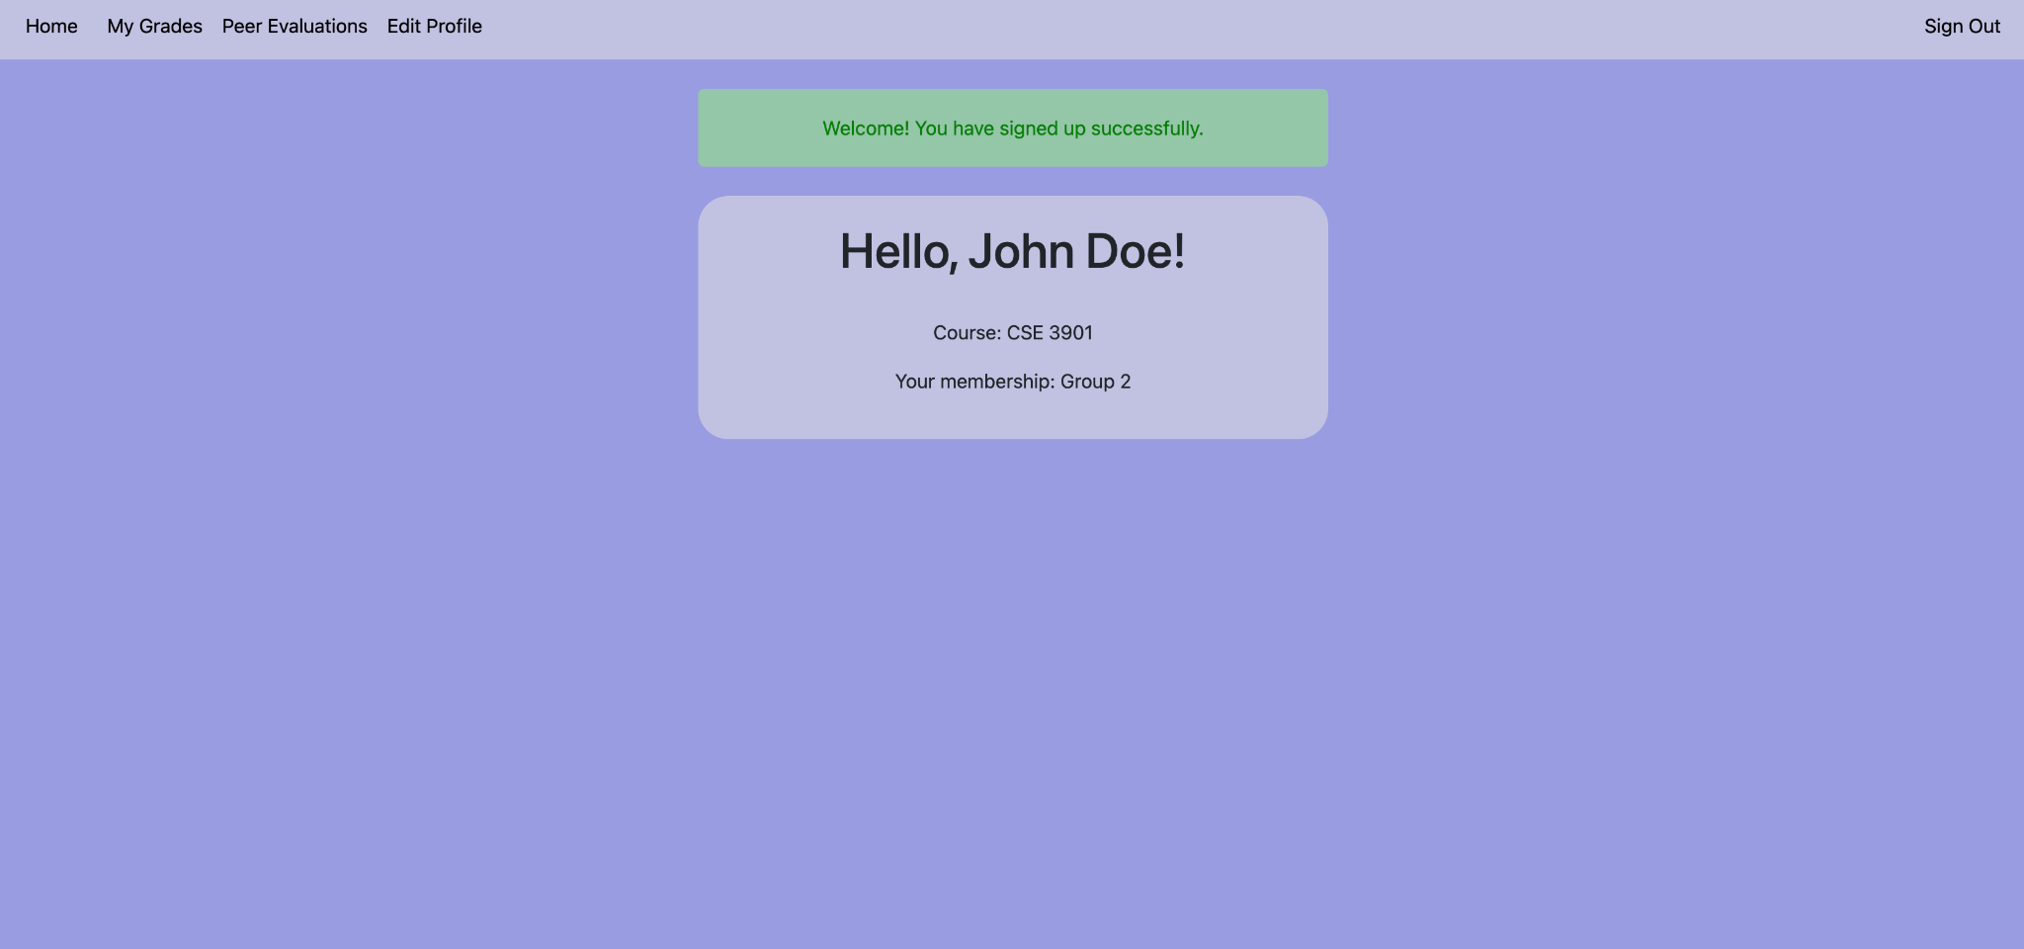
Student GUI

Slide 10
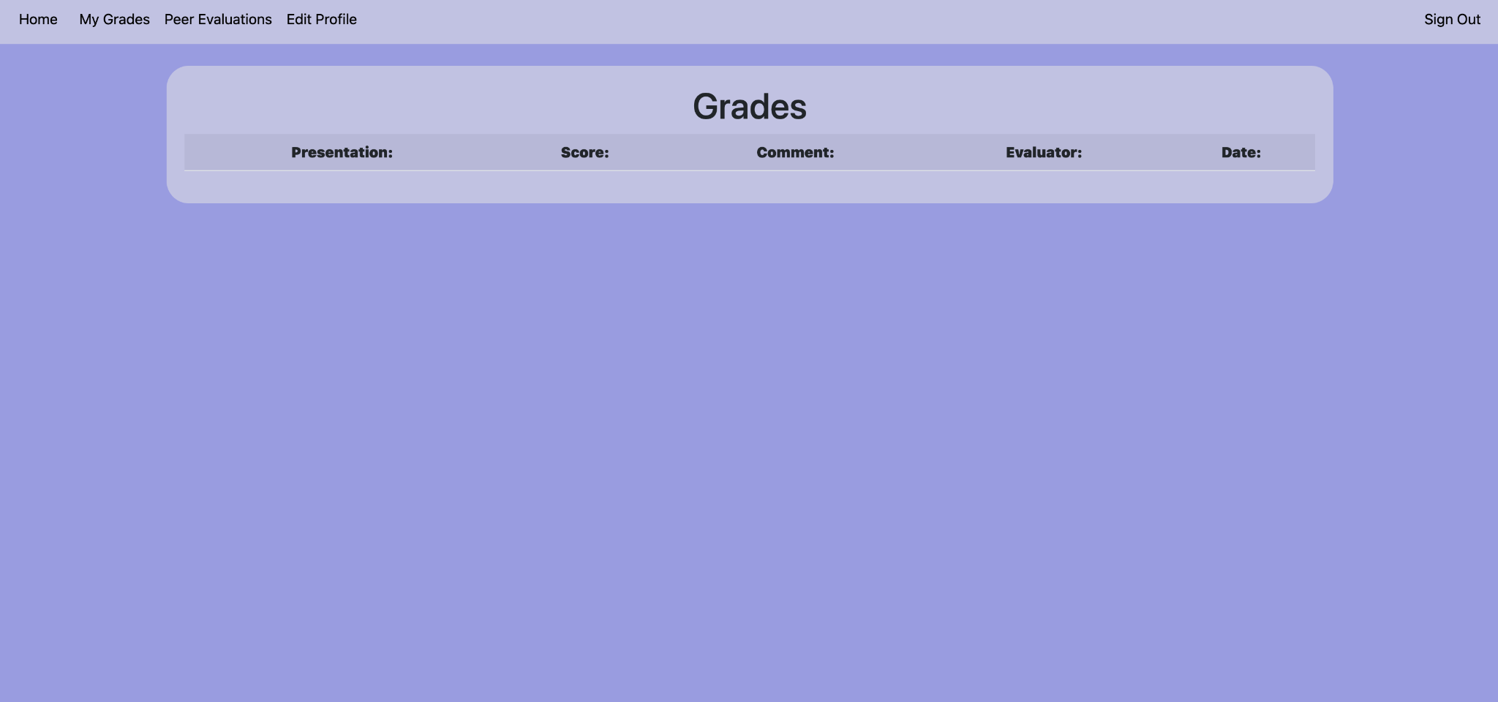
Student GUI - Grades

Slide 11
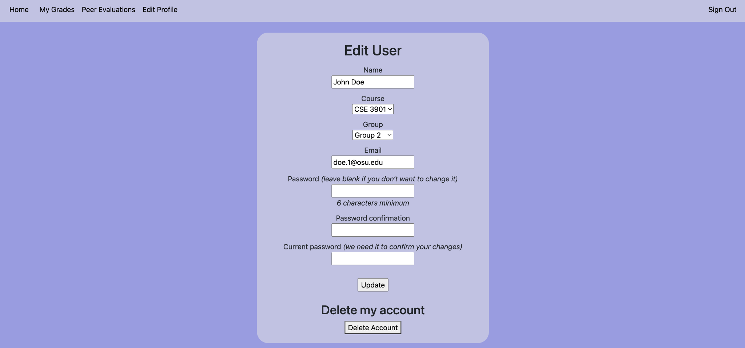
Student GUI - Edit Profile

Slide 12
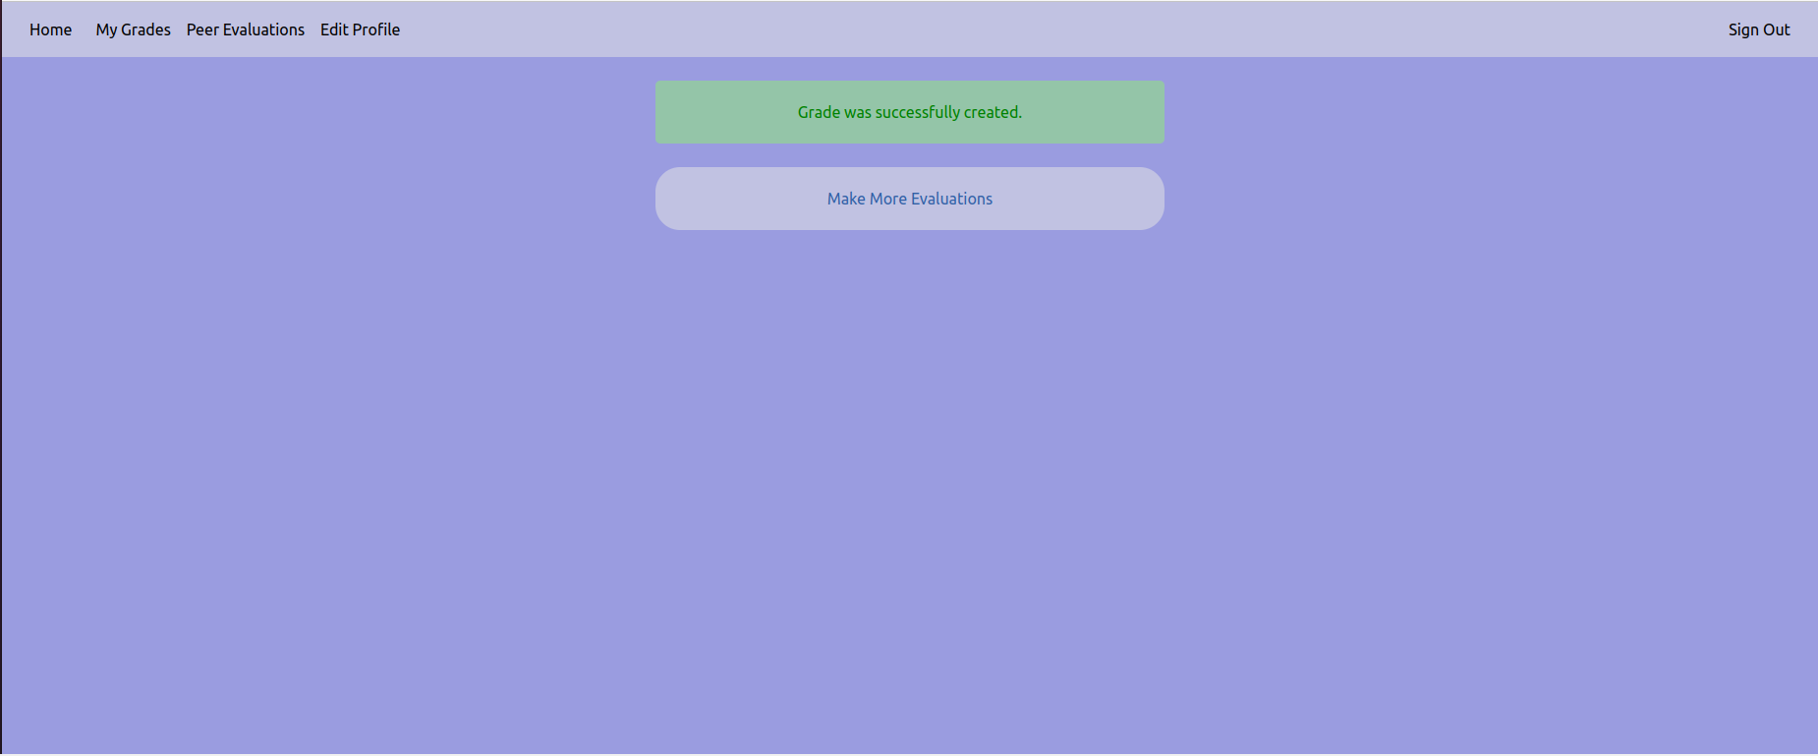
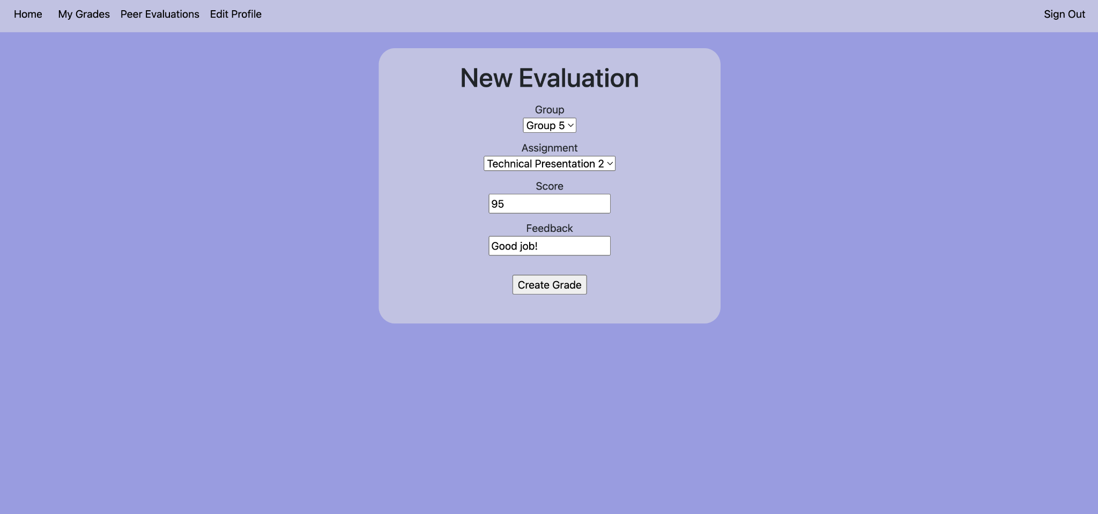
Student GUI - Peer Evaluations

Slide 13

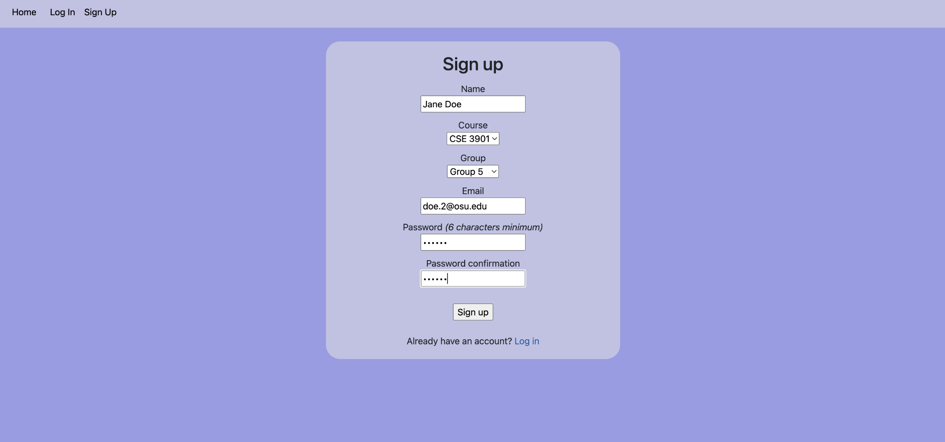
Signing Up as Group 5 to View Feedback

Slide 14
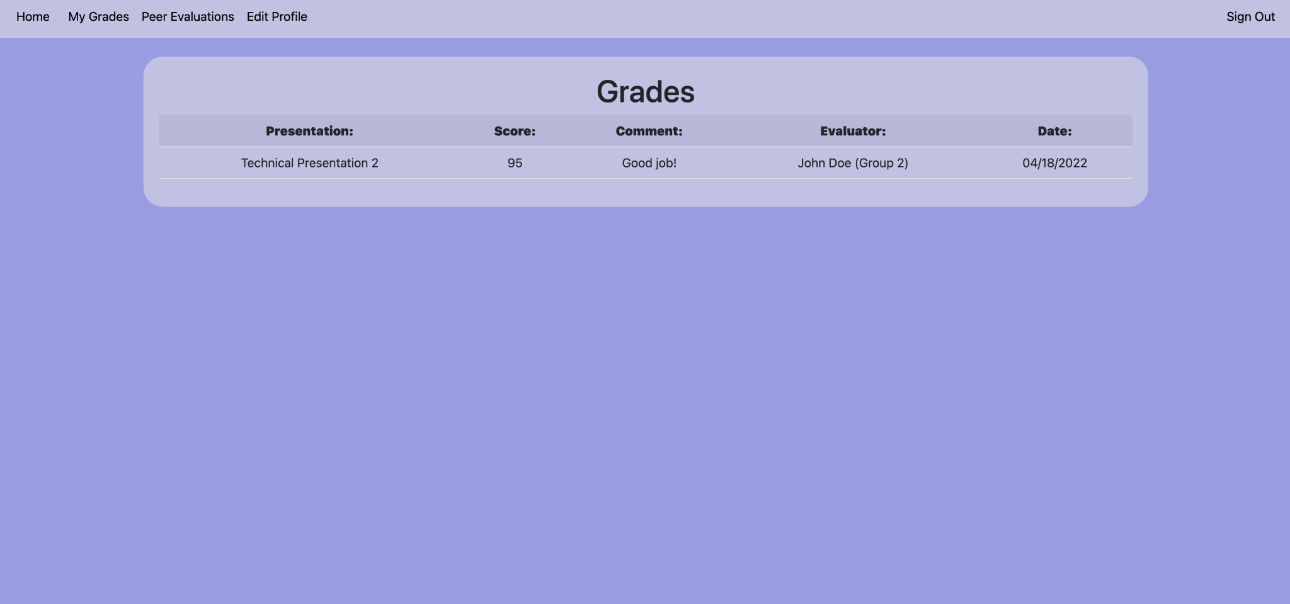
Group 5 Viewing Feedback

Slide 15

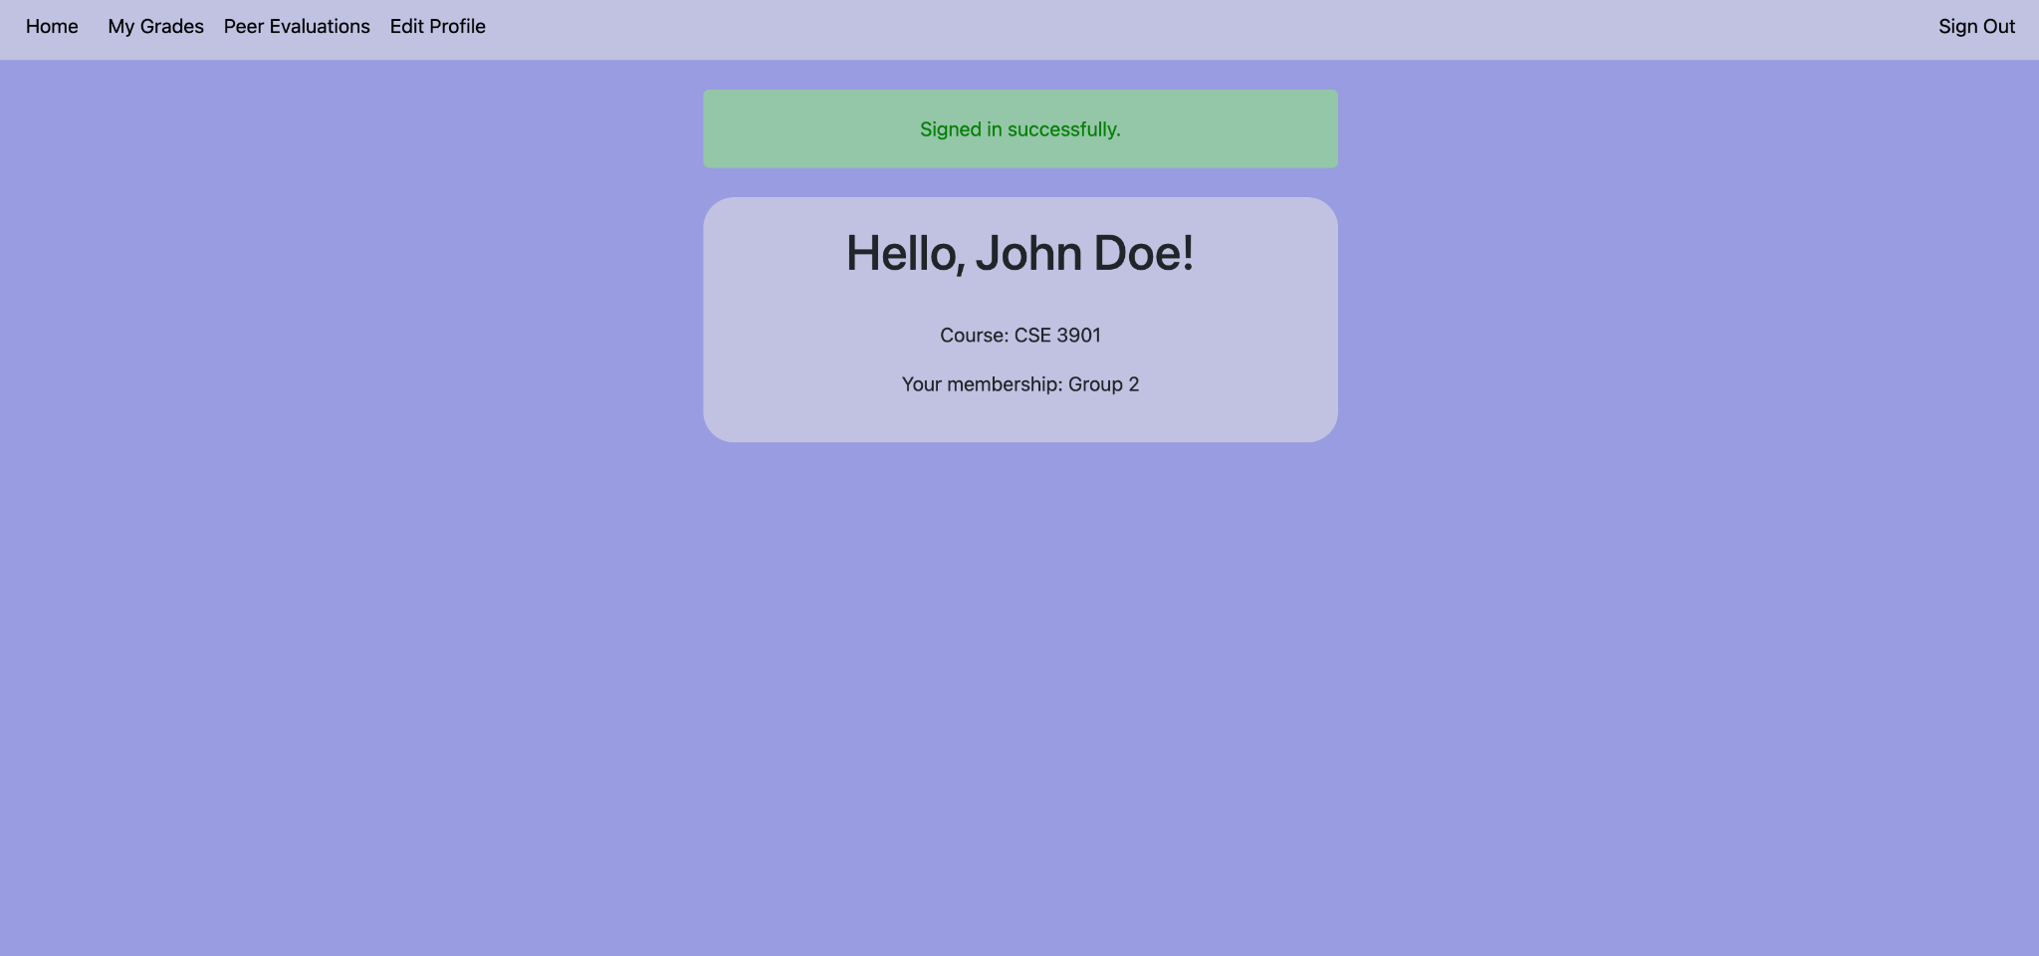

Evaluate Another Group

Slide 16
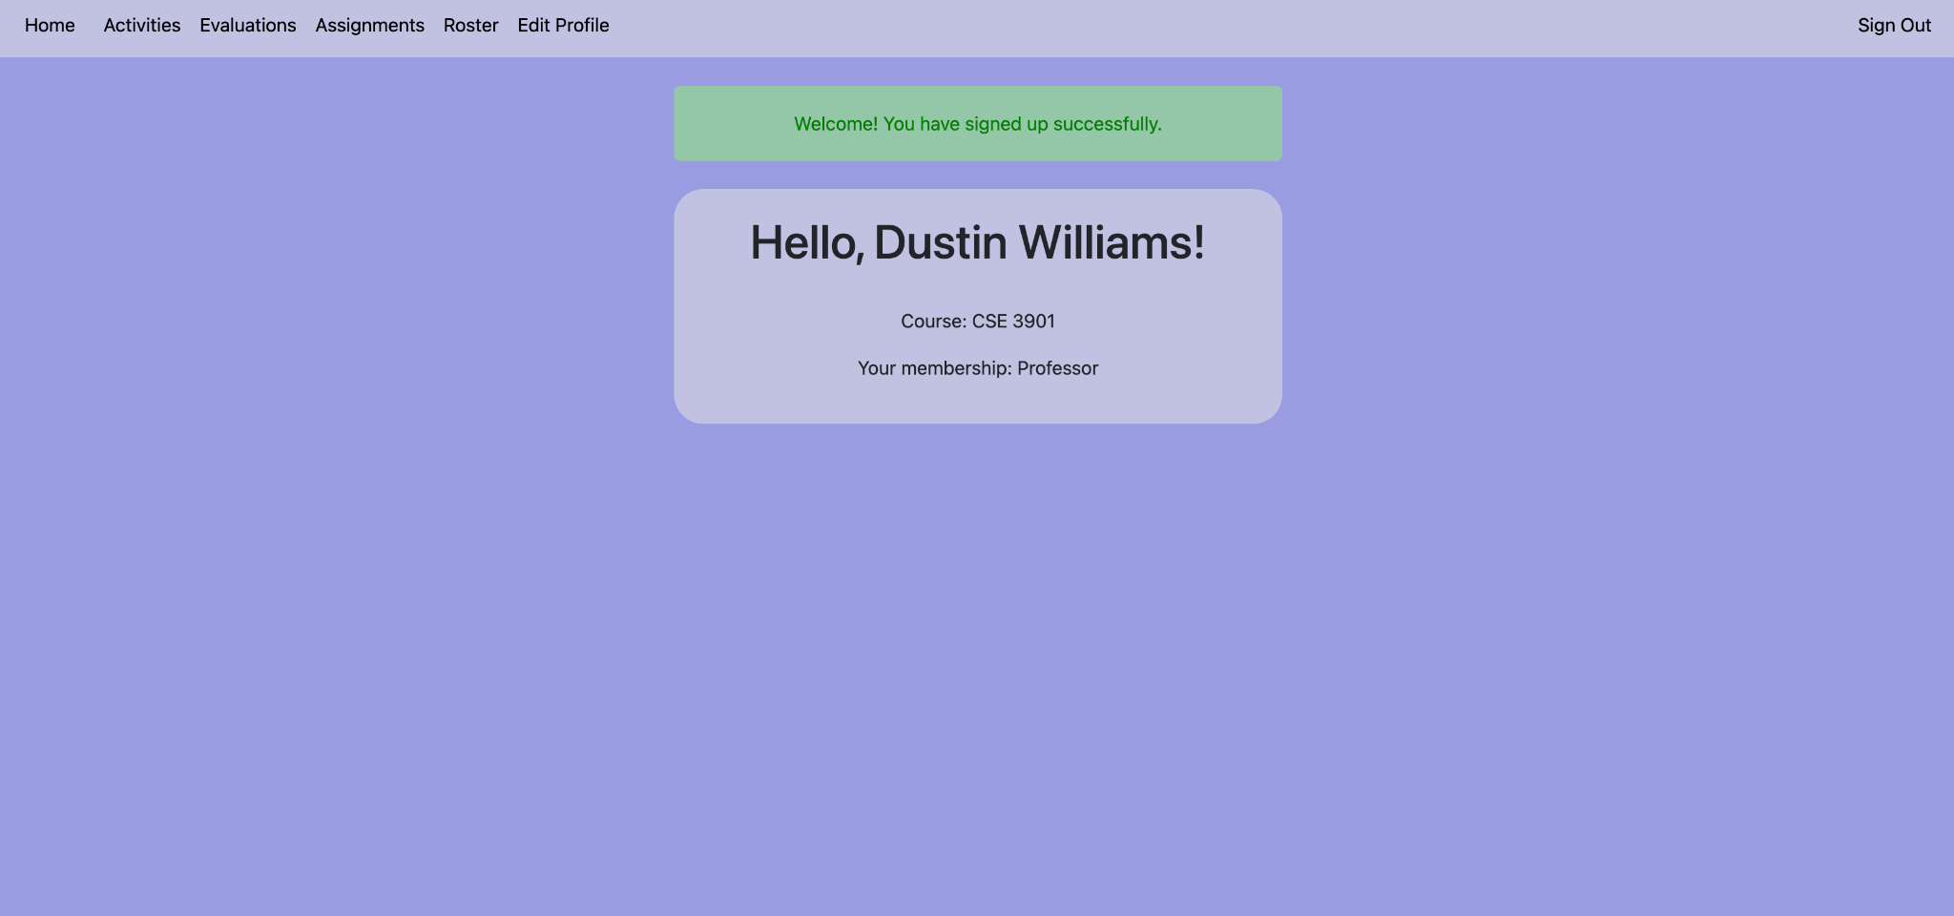
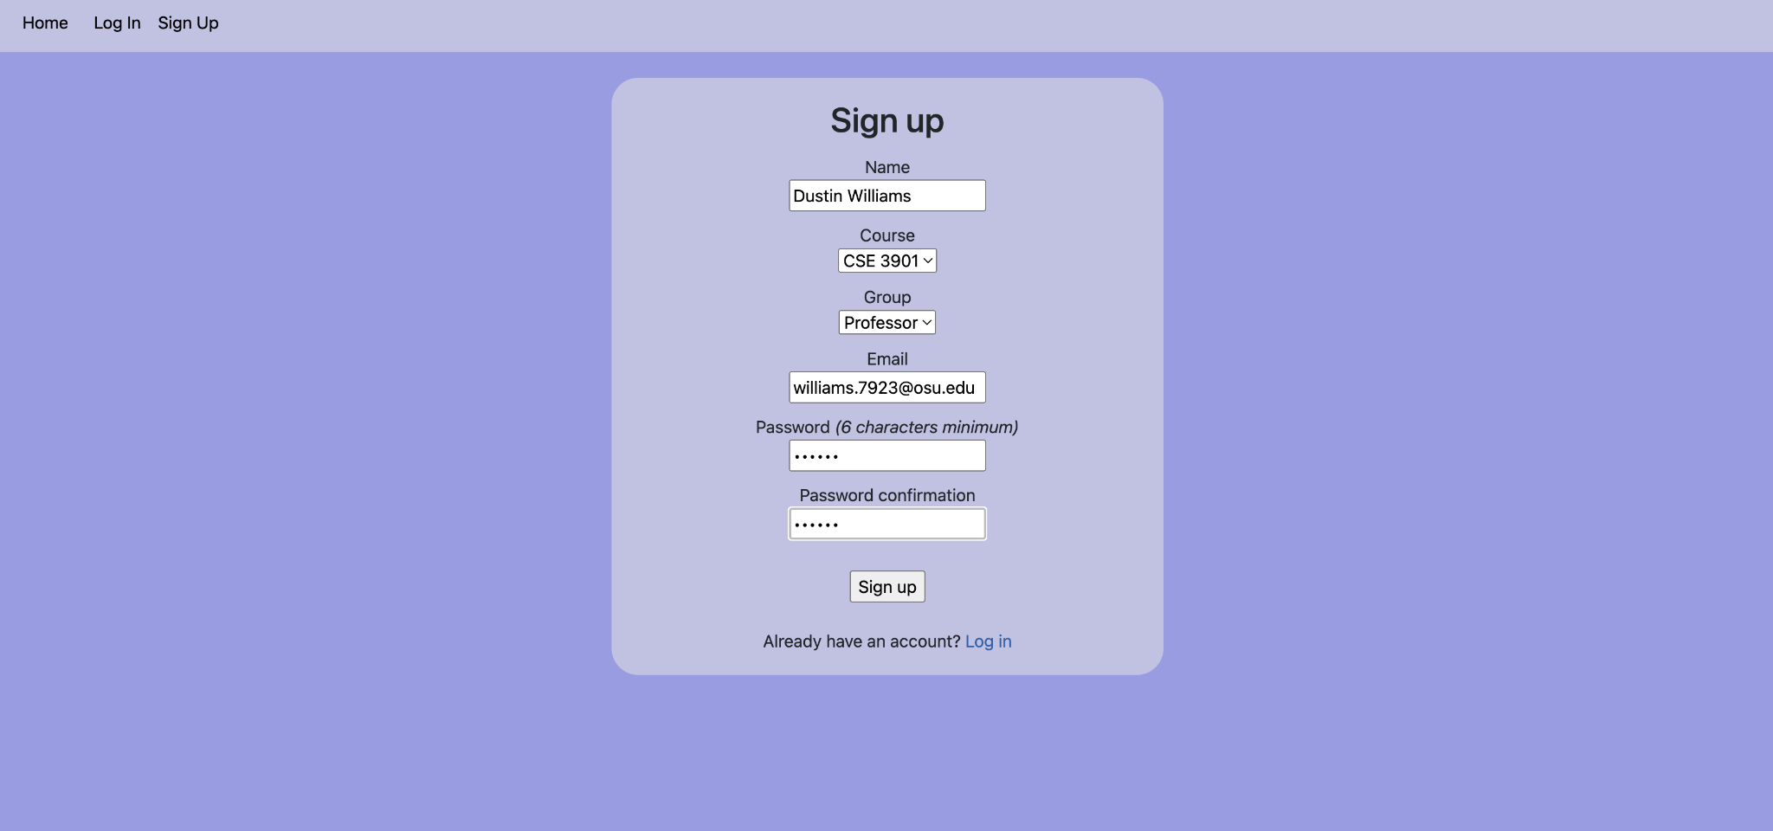
Sign Up as a Professor

Slide 17
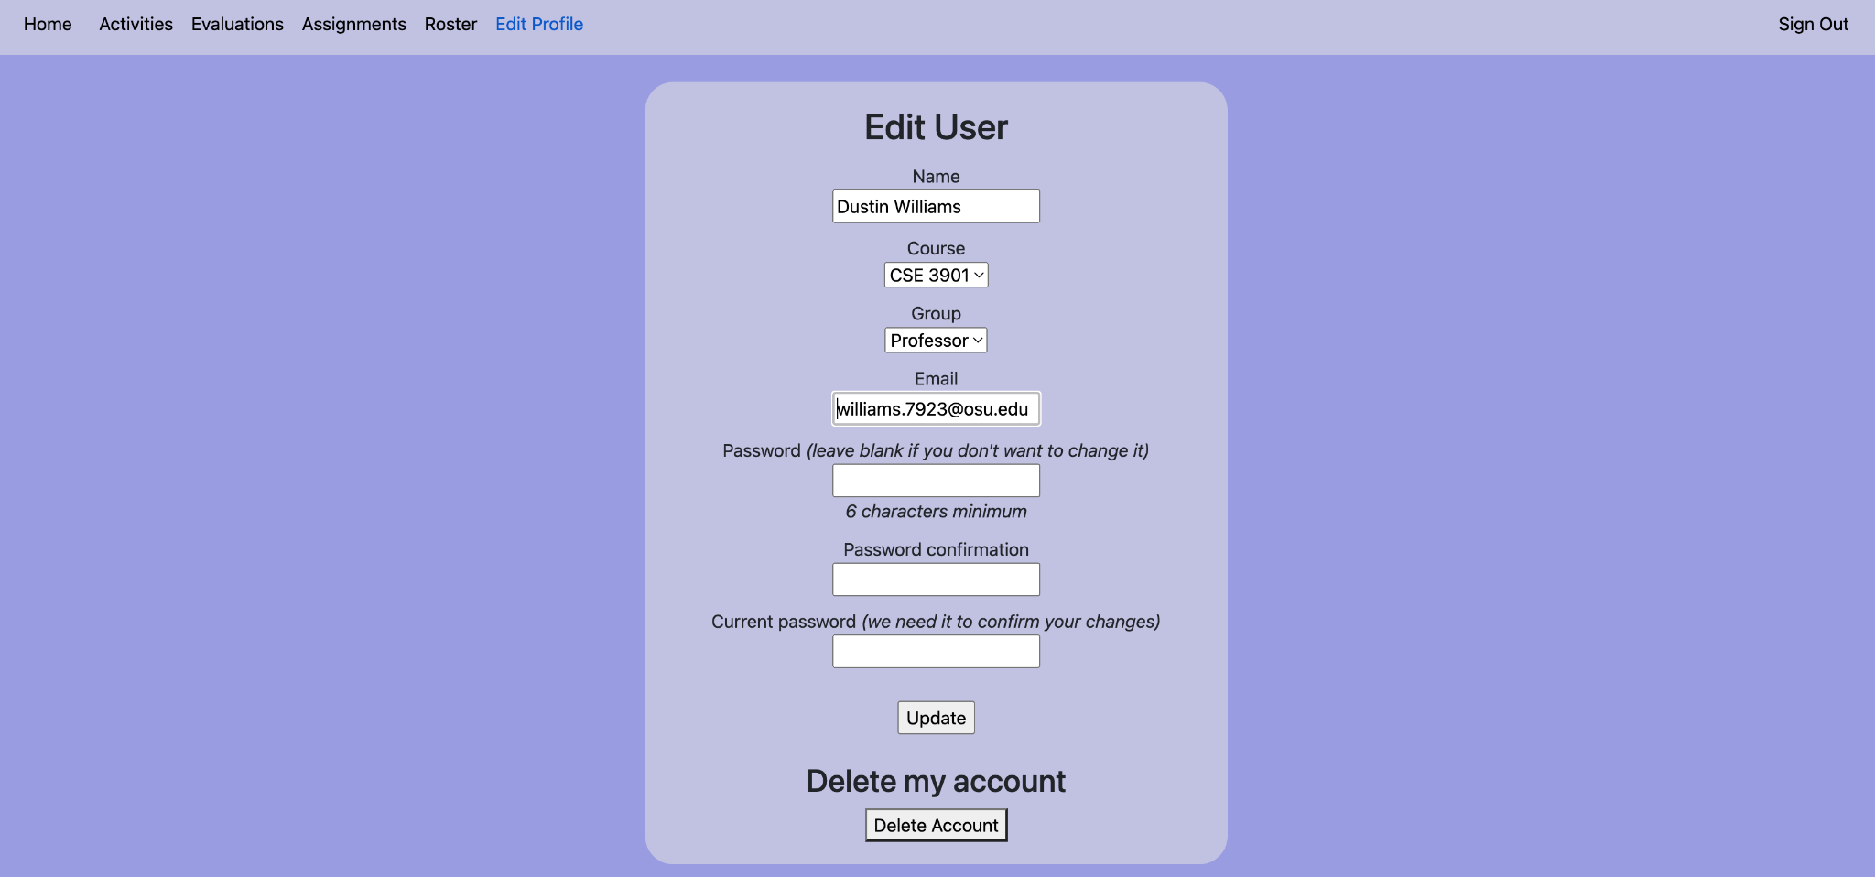
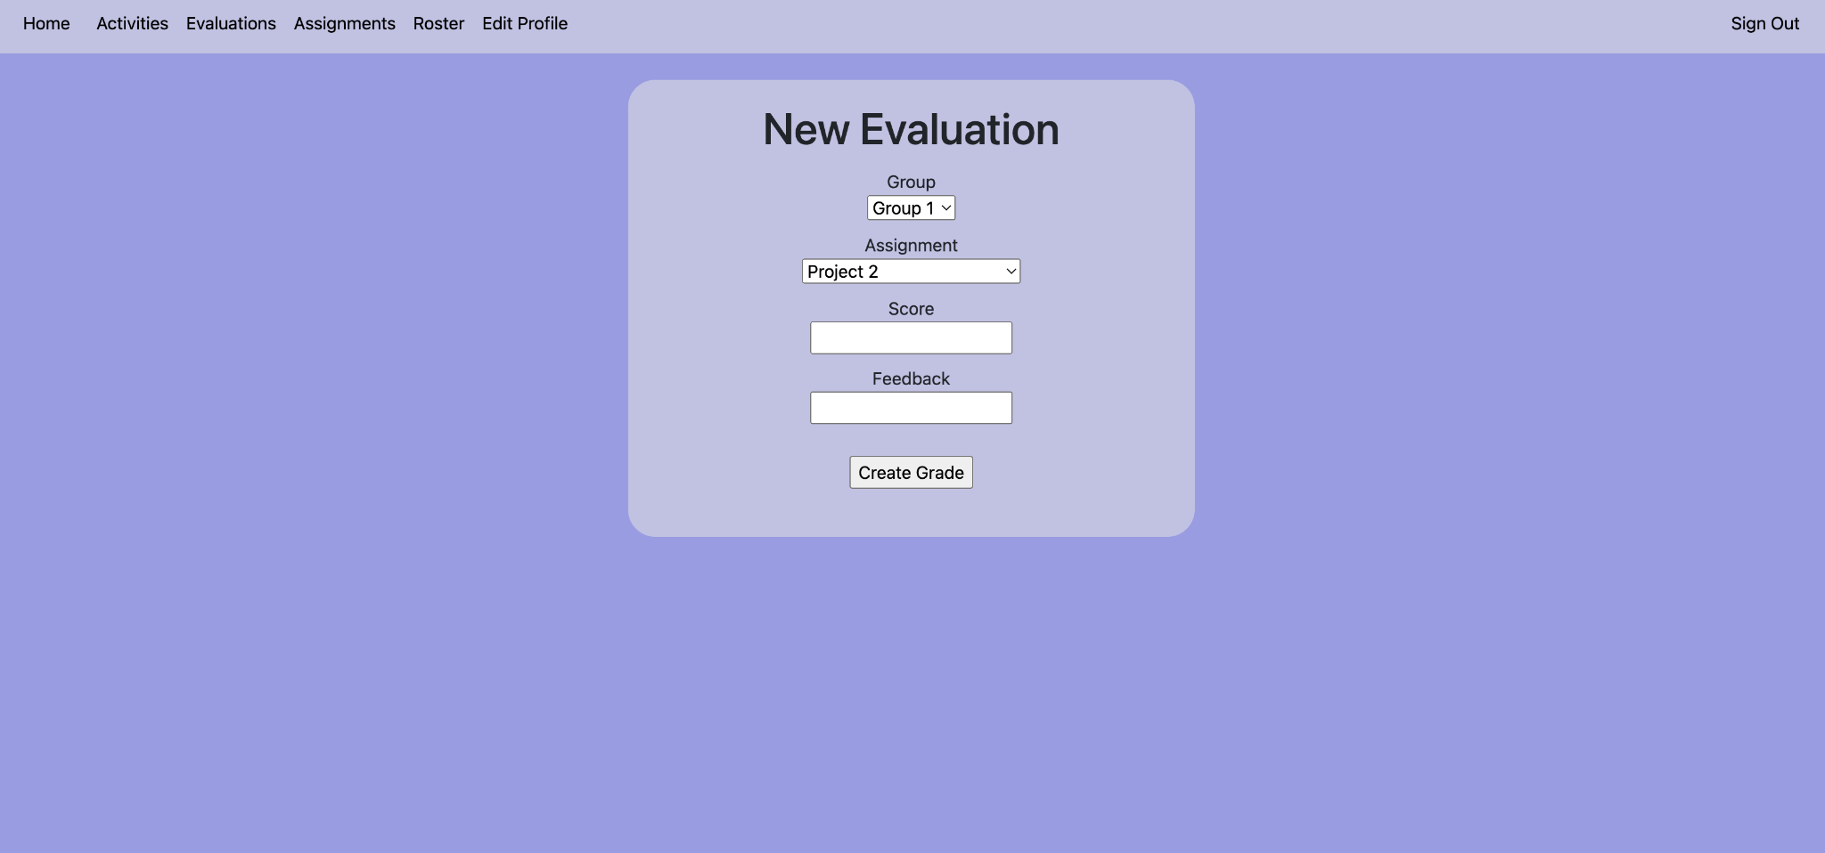
Professor GUI: Evaluations / Edit Profile

Slide 18
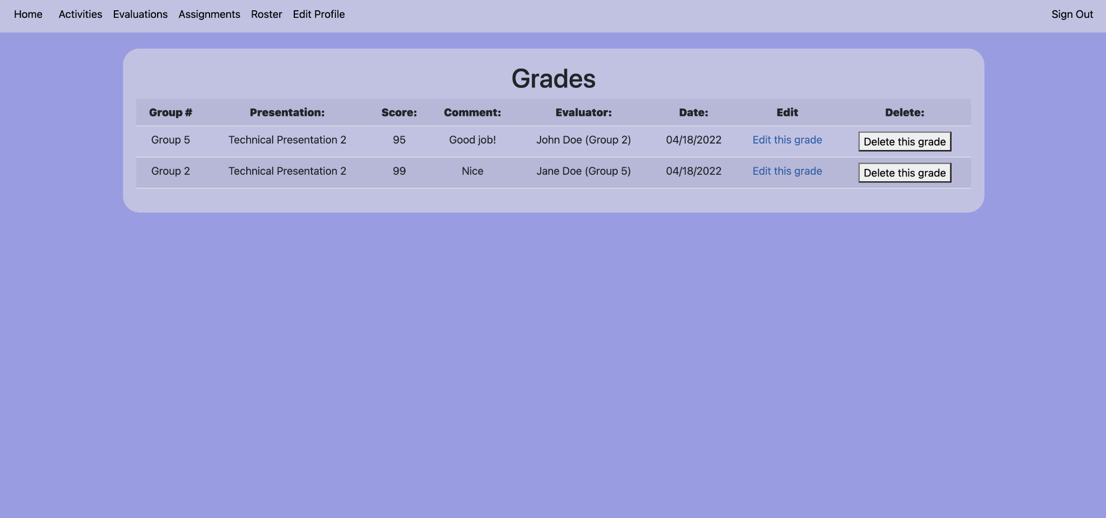
Professor GUI: Student Activities

Slide 19
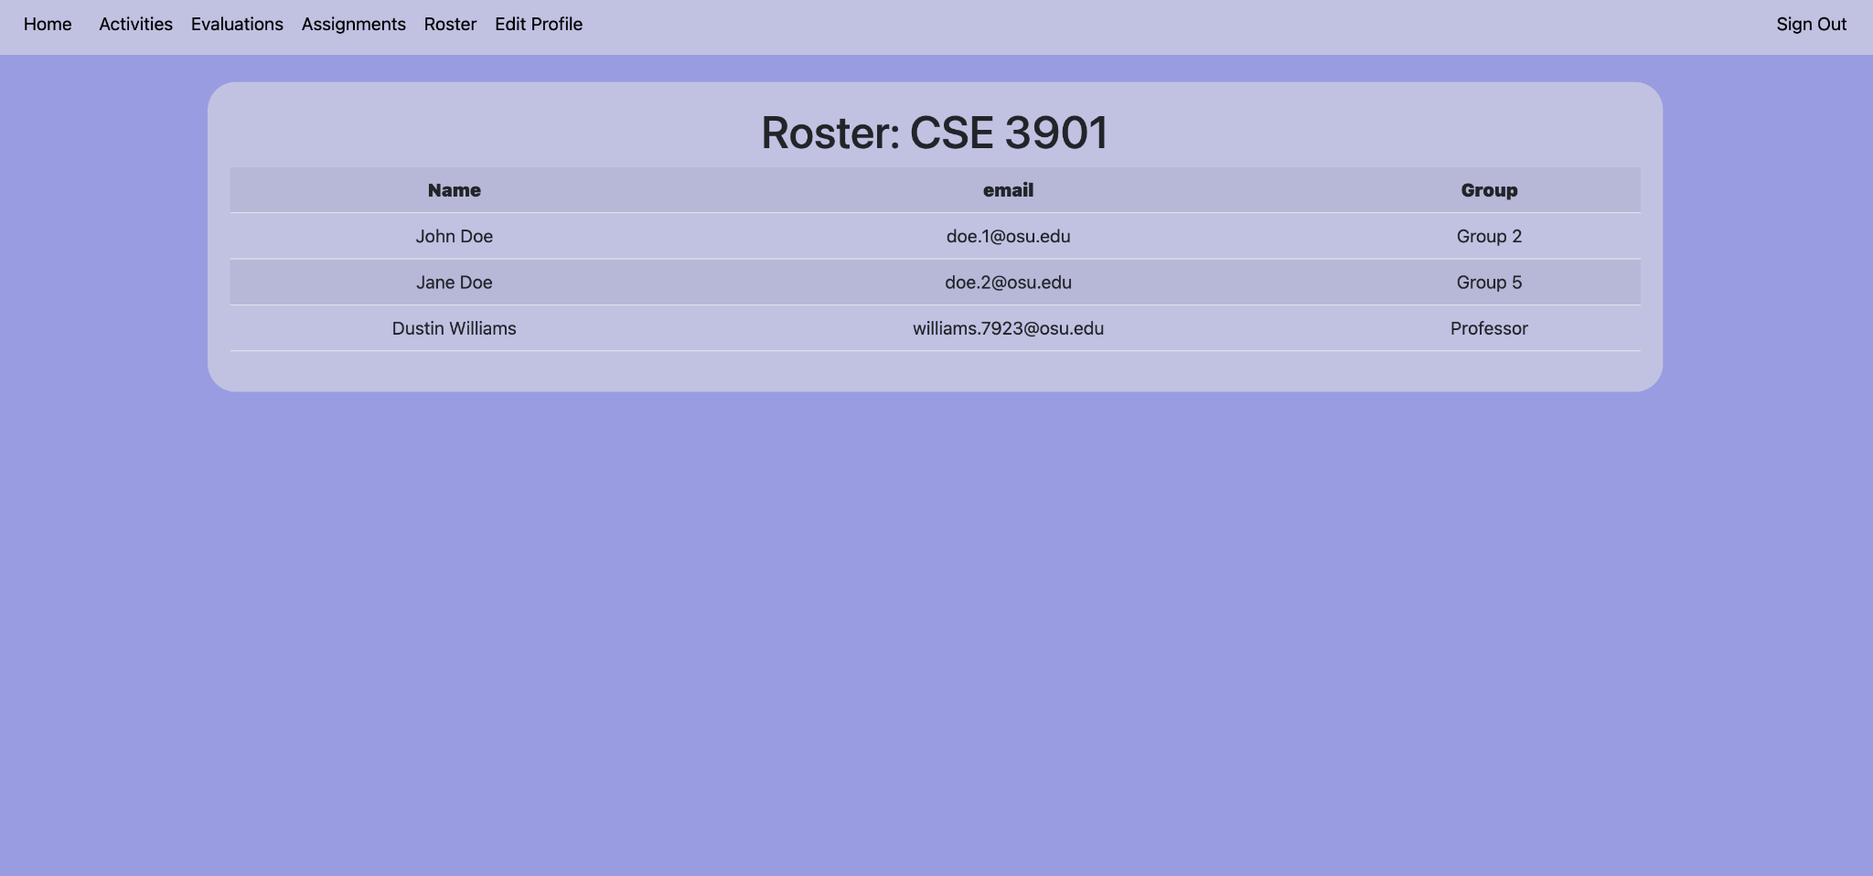
Professor GUI: Roster

Slide 20
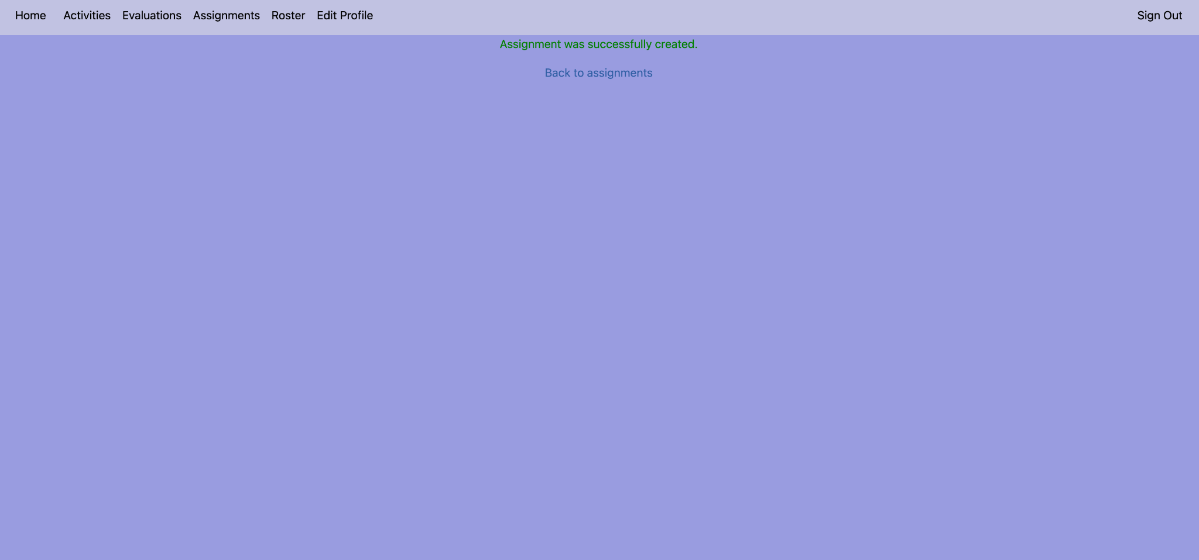
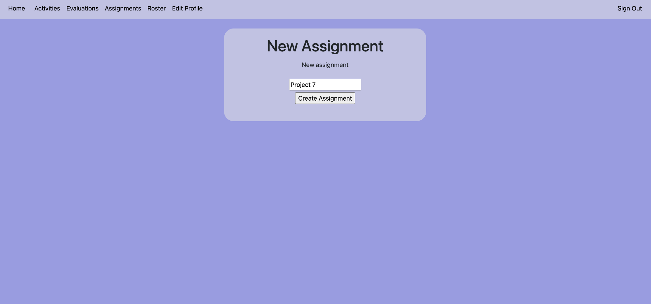
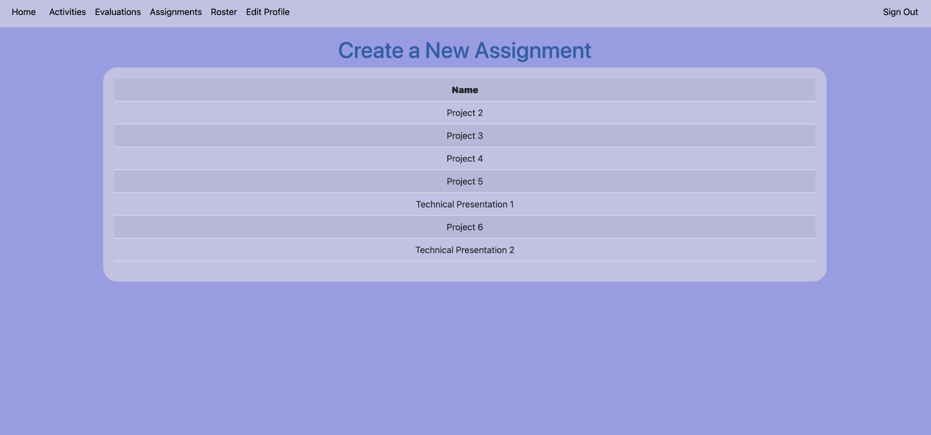
Professor GUI: Viewing / Adding Assignments

Slide 21
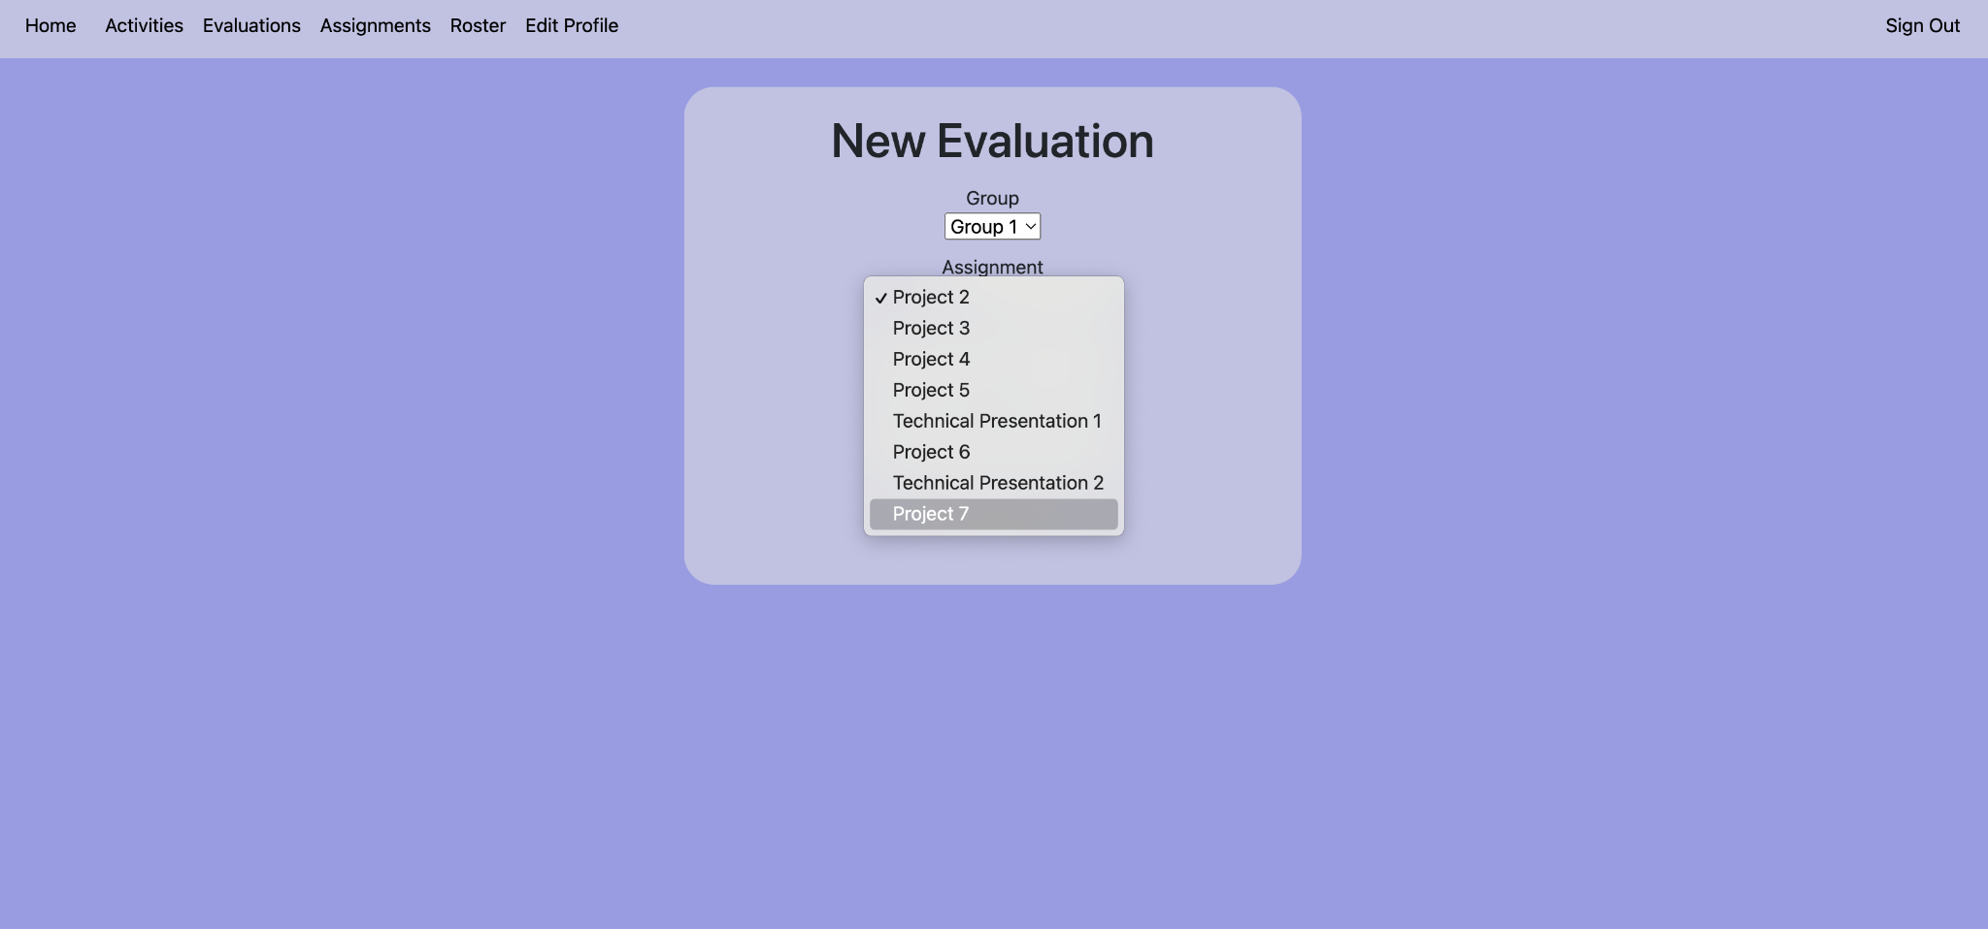
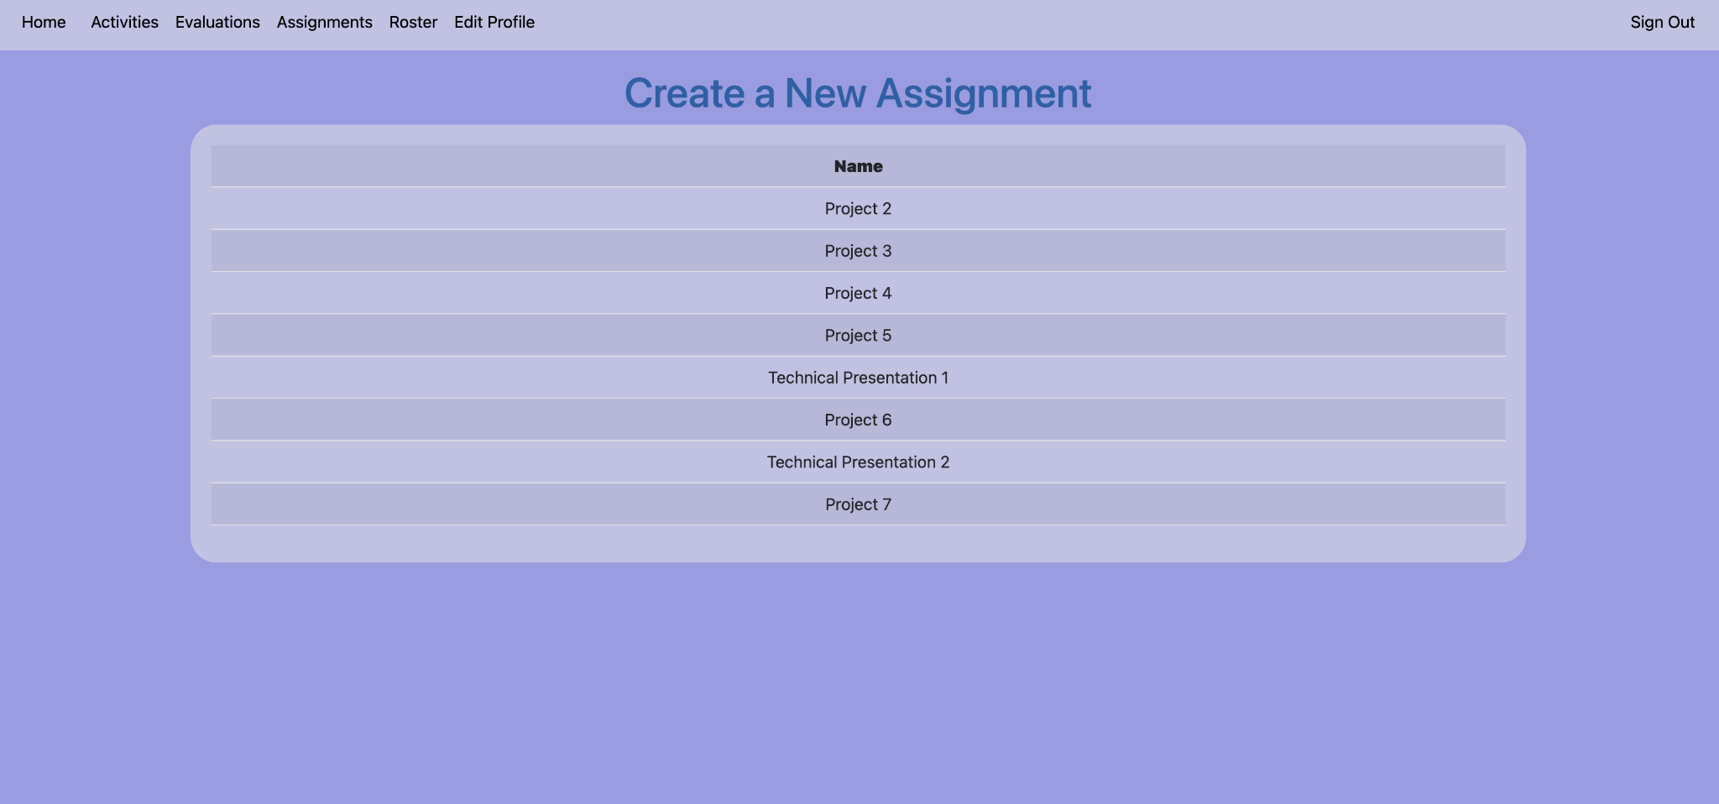
Viewing New Assignments

Slide 22
Database
Presentation Evaluation Tool
Copyrightⓒ. Saebyeol Yu. All Rights Reserved.

Slide 23
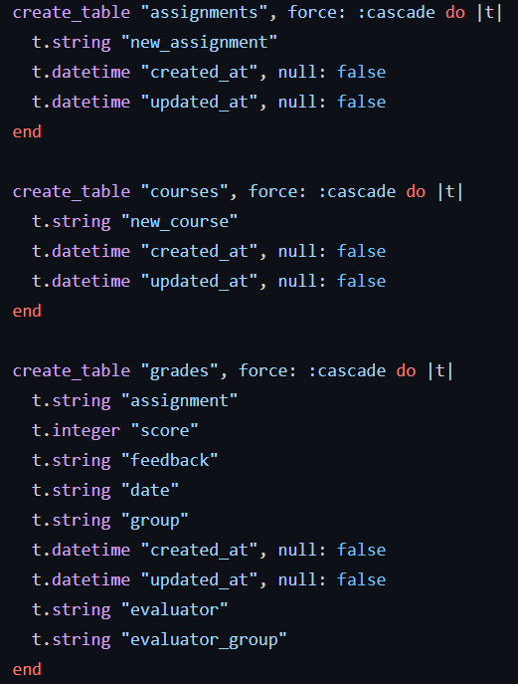
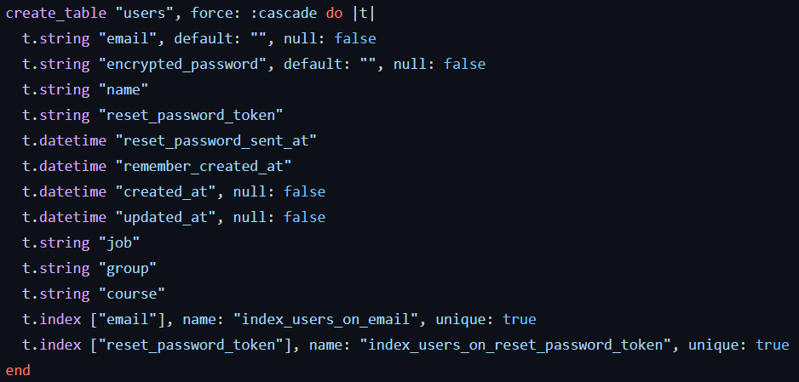
Creating the Database
Created tables for users, assignments, and grades.

Slide 24
Grades
Users
Assignment
assignment
score
feedback
date
group
evaluator
evaluator_group
Auto-generated:
created_at
updated_at
email
encrypted_password
name
job
course
Auto-generated:
created_at
updated_at
new_assignment
Auto-generated:
created_at
updated_at

Slide 25
How to Run the Program
Download ruby 3.1.0.
bundle install
rails db:migrate
rails s

Slide 26
Demo
Presentation Evaluation Tool
Copyrightⓒ. Saebyeol Yu. All Rights Reserved.

Slide 27

Thank You
Copyrightⓒ. Saebyeol Yu. All Rights Reserved.

